Slide 1

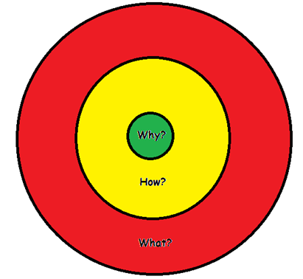
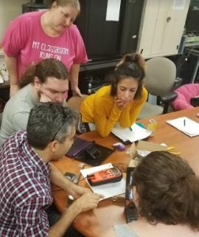
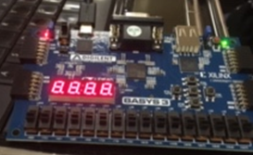

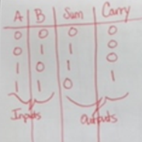



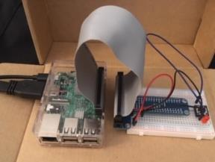
The Power of “Why?”
Using Engineering to Demonstrate and Clarify Knowledge of Energy, Thermodynamics, and Electromagnetic Wave Concepts by Constructing a Rube Goldberg Machine
Jana Simmerly
Apopka Memorial Middle School, Apopka, Florida
Summary
Lesson Plan
Learning Goals
◻Lesson plan designs oftentimes focus on what topics are to be taught and how it will be
accomplished. This uninspiring methodology generally leads to focusing on topics taught
in isolation and without real world connections. But, what better method is there?
How achievement data predicts the future success of the student for which the education
is training that student should be valued more than data of a random survey of factoids
and basic applications.
Simon Sinek, motivational speaker and author of Start with Why,
discusses the concept of The Golden Circle. He explains that
answering “Why?” should come before “What?” and “How?”
This idea should be applied to lesson design and drive each
student’s engagement.
Constructivism, understanding through creating, is an effective
method to motivate students engagement when paired with
providing new information that peaks their interest.
◻The Engineering Design Process is the perfect blending
of providing students structure while building through their creativity.
◻Including new and exciting topics stimulates students’ willingness to
participate and engage in exploring more challenging topics. Within the
proposed lesson, the students will investigate Nuclear Medicine including
Radiopharmaceuticals and PET/CT scanners.
Revisiting new technology that most students did not realize existed
and having the students incorporate that new knowledge into a project
was also designed within this lesson. The concept of Piezoelectricity was introduced
during the Energy unit.
Students will design, create, evaluate and
modify a Rube Goldberg machine.
Prior to Day 1
-Students will have practiced with piezoelectric buzzers & sensors, with coding a robot,
with The Golden Circle Method, and with the Energy, Thermodynamics, and Waves Units.
-Students must follow practiced Expectations & Procedures for Group Projects.
-Pre-Assessment will have already been completed.
Day 1
Project is Introduced with Expectations
- The Scenario is discussed as a class
Students will complete the graphic organizer
Research will be divided equally as a group
Day 2
Students will complete the Research and share
Brainstorming and drawing an idea will be
completed individually
Group members will discuss the parts of each
design that should be on the group design Pages 1 & 2 Student Packet
An agreed on design will be completed along with
a list of needed supplies
- Supplies will be collected and prepared
Day 3
The building responsibilities will be divided and
the group begins to build
Testing while building is recommended
Day 4
Group members will complete the build
Testing & Analyzing will occur if time permits
Day 5
Groups will do a short walk through of all the
other projects and offer constructive feedback
Groups will complete Testing & Analyzing
Groups will discuss the Testing results and any
feedback offered
The group members will agree on modifications
and draw or list the changes needed
Day 6
- Groups will make modifications and Test & Analyze
Decide how the group will present and what will
be said.
⬇Project should be finished by the end of class!⬇
Day 7
- Set up machine for Presentations
- Each Group will Present their machine and explain
their thoughts on their design
- Class members are to be supportive of other groups
After the Completed Project
Each student will complete an Individual Reflection Assignment with a list of choices
Option 1: Video the machine in process and add your voice explaining the science concepts
Option 2: Write an Essay describing the Science behind the Machine
Option 3: Draw a Rube Goldberg machine and write detailed information of the science
The Post-test is the Formative Assessment & the Project and Assignment is the Summative.
1. To demonstrate an understanding of Energy transformations to
effectively design a Rube Goldberg machine.
2. To demonstrate how adding or removing heat will increase or
decrease energy and effectively design that component in the Rube
Goldberg machine
3. To demonstrate how the Electromagnetic Spectrum along with
Wave Concepts illustrate amounts of energy and effectively design
that component in the Rube Goldberg machine
4. To integrate varying concepts while able to distinguish between
how Energy & Heat, Energy & EM Spectrum, and Energy & Waves
are related and differ.
The Golden Circle by Simon Sinek.
Sinek’s TED Talk Clip on The Golden Circle.
Instructional Strategies
Cooperative Learning Inquiry-Based Learning
Effective Questioning Graphic Organizers
Generating and Testing Hypotheses
Project-Based Learning Graphic Organizers
RET Research Experiences
Micro-Electrical-Mechanical Systems (MEMS) Resonant Sensors
Investigated Resonance and Piezoelectricity
Tuning Forks Microphone Piezoelectric Buzzer & Sensor
Observed MEMS sensor testing within vacuum at different temperatures
 Calculated Temperature Coefficient of Frequency(Tcf) Q Factor
Hardware Embedded Systems
Basys3 FPGA programmed in Verilog Logic Gates Truth Tables
Software, Networking, & Mobile Programming
Layers Protocols Security & Privacy Issues Raspberry Pi 3
Java Android Studio Raspberry Pi 3 Programming
Acknowledgments
Tuning Fork
RET Site: COMET Program, College of Engineering and Computer Science, University of Central Florida. This content was developed under National Science Foundation grant EEC-1611019.
References
Microphone Connected
to Oscilloscope
MEMS Sensors in
Vacuum Chamber
Observing Thermoelectric
Cooling
Anderson, William L., Mitchell, Steven, & Osgood, Marcy P. “Comparison of Student Performance in Cooperative Learning and Traditional Lecture-Based Biochemistry Classes.” Biochemistry and Molecular Biology Education 33, no. 6 (2005): 387–93. https://doi.org/10.1002/bmb.2005.49403306387.
Daly, Shanna, and Kelly Hutchinson. “Incorporating Nanoscale Science and Engineering Concepts into Middle and High School Curricula.” Accessed July14, 2019. http://www.icee.usm.edu/ICEE/conferences/asee2007/papers/1686_INCORPORATING_NANOSCALE_SCIENCE_AND_ENGI.pdf
Duncan, Kara. “Radiopharmaceuticals in PET Imaging.” Journal of Nuclear Medicine Technology 26, no. 4 (1998): 8.
Electrical Projects [Creative Lab]. Thermoelectric Cooler - Device That Makes Ice and Electricity, 2018. [Video File] https://www.youtube.com/watch?v=rT9-HUzUqhQ&feature=youtu.be.
Ertmer, Peggy, and Newby, Timothy. “Behaviorism, Cognitivism, Constructivism: Comparing Critical Features From an Instructional Design Perspective.” Performance Improvement Quarterly 6 (October 22, 2008): 50–72. https://doi.org/10.1111/j.1937-8327.1993.tb00605.x.
Guo, Lukai, and Qing Lu. “Potentials of Piezoelectric and Thermoelectric Technologies for Harvesting Energy from Pavements.” Renewable and Sustainable Energy Reviews 72 (May 2017): 761–73. https://doi.org/10.1016/j.rser.2017.01.090.
Holmes, Nelson. (May 9, 2012) TED: Simon Sinek - "The Golden Circle" Clip. [Video File] Accessed July 13, 2019. https://www.ted.com/talks/simon_sinek_how_great_leaders_inspire_
action.
Ikeda, Takuro. Fundamentals of Piezoelectricity. Oxford ; New York: Oxford University Press, 1990.
Ikotun, Oluwatayo, Bonnie Clarke, and John Sunderland. “A Snapshot of United States PET Cyclotron and Radiopharmaceutical Production Operations and Locations.” Journal of Nuclear Medicine 53, no. supplement 1 (May 1, 2012): 1085–1085.
IAEAvideo. (October 5, 2017) “Radiopharmaceuticals - a Key Component of Nuclear Medicine” [Video File] Accessed July 15, 2019. https://www.youtube.com/watch?v=8YlABLzefKg.
Jennings, D., Surgenor, P., & McMahon, T. (2013). Education Theory/Constructivism and Social Constructivism in the Classroom - UCD - CTAG. Ucdoer.ie. Accessed July 13, 2019. http://www.ucdoer.ie/index.php/Education_Theory/Constructivism_and_Social_Constructivismin_the_Classroom.
Lee, Hee-Sun, and Ou Lydia Liu. “Assessing Learning Progression of Energy Concepts Across Middle School Grades: The Knowledge Integration Perspective.” Science Education 94, no. 4 (July 2010): 665–88. https://doi.org/10.1002/sce.20382.
LLUHealth. (October 24, 2017) “Nuclear Medicine” [Video File] Accessed July 15, 2019. https://www.youtube.com/watch?v=oWVsnFz-KqA.
Matthews, William J. “Constructivism in the Classroom: Epistemology, History, and Empirical Evidence.” Teacher Education Quarterly 30, no. 3 (2003): 51–64.
Najafi, Hamidreza, and Keith A. Woodbury. “Optimization of a Cooling System Based on Peltier Effect for Photovoltaic Cells.” Solar Energy 91 (May 1, 2013): 152–60. https://doi.org/10.1016/
j.solener.2013.01.026.
TED-Ed. (June 20, 2017) “How to Squeeze Electricity out of Crystals - Ashwini Bharathula.” [Video File] Accessed July 15, 2019. https://www.youtube.com/watch?v=YEJ2qryXcIQ.
Simmerly Soldering
(T to B) Piezo Sensor & Piezo Buzzer
(L to R) FPGA, Logic Gates, Truth Table
(L to R) CodingGround, Java Logo, Android logo,
Scratch logo & Raspberry Pi 3

